Slide 1
ONLINE HOME SERVICES

Slide 2
Team Members Contribution
Member Name | Role
Pavithra Telukuntla | Frontend
Srujana Pamidimukkala | Frontend
Akhila Katkuri | Frontend
Anusha Todupunoori | Frontend/Backend
Vivek Vardhan Gutta | Backend/Database
Rajashekar Reddy Chirumani | Backend/Database
Harshit Reddy Nagireddy | Frontend
Anwar Hussain Shaik | Backend/Database

Slide 3
ABSTRACT
“ONLINE HOME SERVICES” as the title of the project indicates various home services are provided to the customers and can be booked online through a provided web application. Here the customer can fix all his home problems like washing machine repairs, geyser repairs, plumbing fixes, carpentry works etc.. Door step services are offered to the customer 24/7 and finally the customer gets satisfied with our service provided.

Slide 4
Contents
Introduction
Requirement Specification
Modules
Implementation
Working
Output Screenshots
Conclusion

Slide 5
Introduction
The main aim of the project is to make common mans life easier. In todays world a common man is facing lot of problems due to the unavailability of proper home services. In our day to day life when something got repaired in our home we will fix that issue by contacting workers, and here the problem arises that the workers may not be available or they may charge huge amount of money even for small repairs and we keep on searching for worker who satisfies us. Through this web application he can solve all the home problems by getting door step services at reasonable charges.

Slide 6
Requirements Specification
Hardware Requirements: Laptop/Desktop, RAM(min 2 Gb), ROM(min 500 GB), processor (min intel3)
Software Requirements : Operating System- Windows/ Linux/ MAC, NetBeans IDE with JDK, MYSQL, Apache Tomcat Server (optional), Browser( Google Chrome, Microsoft Edge, Mozilla Firefox..)

Slide 7
MODULES
Administrator Module
User Module
Worker Module

Slide 8
Administrator Module
The admin is the one who has all the rights. He manages complaints of customers. He sends all the details of customers complaint to specific worker and manages all the workers. After work done by the worker, he updates the work status to the Admin. The Admin checks the review provided by the customer and takes necessary actions there after.

Slide 9
User Module
User is the one who interacts with the webpage and chooses his problems. The user provides various details like name, contact details and location. After work completion, he makes payment and gives feedback based on the work satisfaction. Later, the user decides to revisit the page or not.

Slide 10
Worker Module
Here, worker is the one who plays main role in satisfying the customer. The business growth depends on his work. Worker will get all the customer and the type of the problem he has to fix. The worker goes to the location and fixes the problem. After work completion, he will send updates to the admin and admin will update the status of work. Finally, the worker collects the amount from the customer.

Slide 11
Implementation
In the front-end HTML is used. All the HTML pages will get displayed according to the code written. In the Backend NetBeans is used. NetBeans with JDK has to be installed. MYSQL has to be installed. Database setup is done through MYSQL Workbench. MYSQL workbench will get installed during the installation process of MYSQL.

Slide 12
Working
A web link is shared to everyone. On clicking it, both the user and Admin registers and logins. The user is navigated to the home page and selects the service based on the requirement. Later, he is navigated to a page where all his details like name, mobile number, address has to be entered. Now comes the role of the admin, who manages all the complaints. He sends the worker to the prescribed location. After work completion, the worker updates it to the admin and the admin updates the work status. After, the worker collects the amount from the customer. The customer later gives the review and the business growth is based on the customer.

Slide 13
Test Cases
Step No. | Test Case | Step Description | Expected Output | Actual Output | Result
1 | Installing NetBeans | Installing NetBeans | Installed | Installed | Success
2 | Running html Code | Running html Code | Executed | Executed | Success
3 | Running html Code | Running html Code | Executed | Not Executed (if Code is incorrect) | Fail
4 | Running jsp Code | Running jsp Code | Executed | Executed | Success
5 | Running jsp Code | Running jsp Code | Executed | Not Executed (if Code is incorrect) | Fail
6 | User Registration | User entering his details like Username, Password, Mail ID for sign up | Successfully signed up | Successfully signed up | Success

Slide 14
7 | User Login | Enters Username or Password incorrectly | Successfully logins | Login Fails | Fail
8 | Services page | After successful login, services page is displayed | Displays Home page | Displays Home page | Success
9 | Services page | If login fails, services page is not displayed | Displays Home page | Home page is not displayed | Fail
10 | Database Setup | Database Connection | Database Connected | Database Connected | Success
11 | Database Setup | Database Connection | Database Connected | Database not connected | Fail

Slide 15
Feedback
The feedback received is quite good since all the features promised are implemented in the project. They suggested to change the payment mode to worker from cash to online transaction. But it is not changed because all the workers may not have required applications for online transactions and all the workers may not have bank accounts. Except this the feedback received is quite good.

Slide 16
Code Inspection Results
During code inspection, the opponent team verified whether all the features are included or not. They verified the correctness of the core functionalities mentioned and also verified the hardware and software requirements of the project. They also verified whether all the UML diagrams such as Use Case, Class, Sequence diagrams are correct or incorrect. After total project verification the feedback received is quite good.

Slide 17
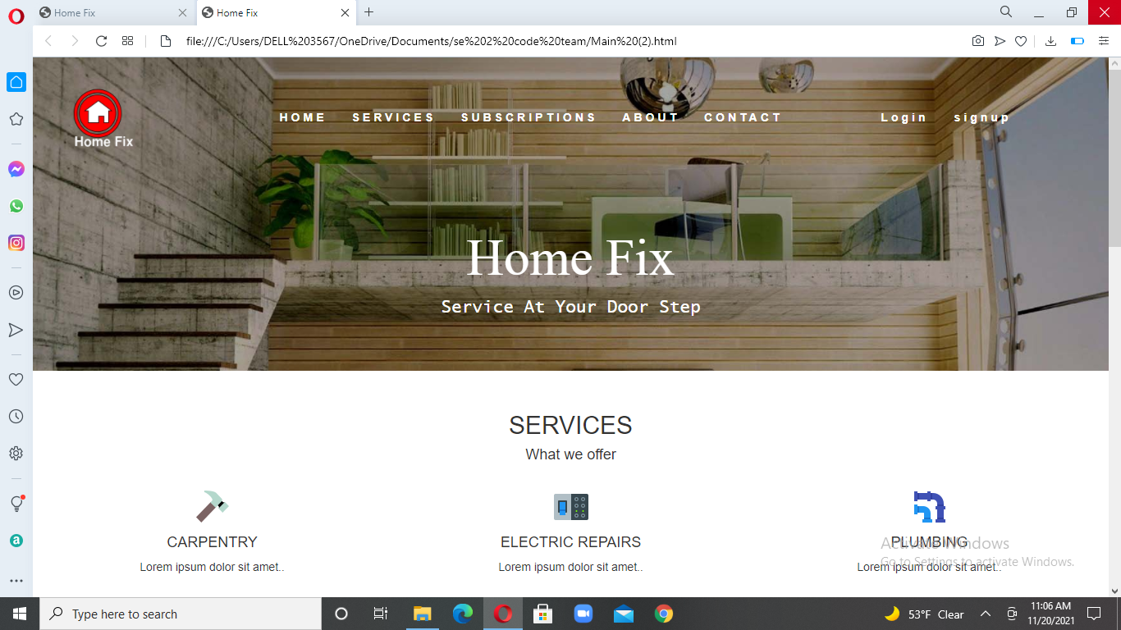
Output Screenshots

Slide 18
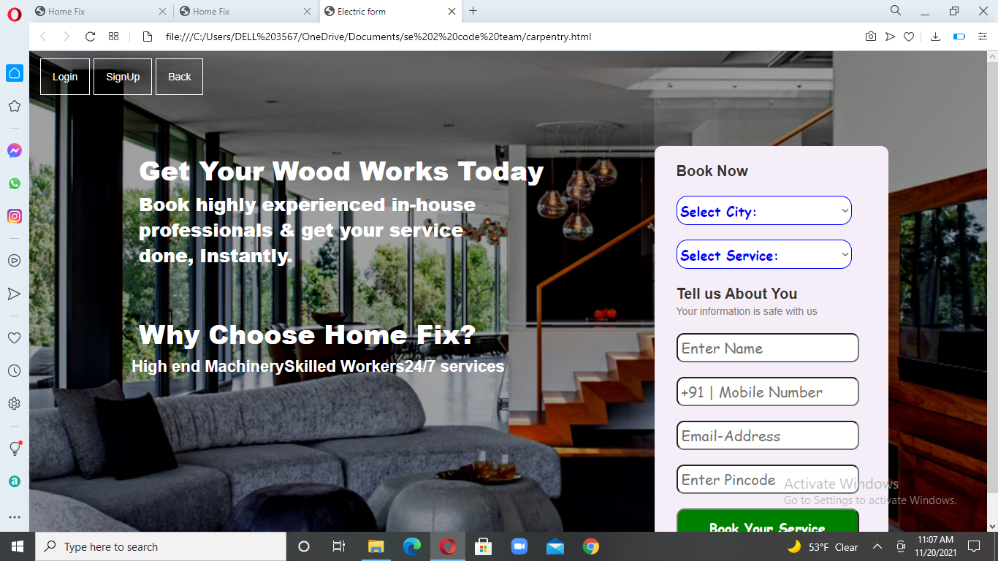

Slide 19
Conclusion
The project is successful in carrying out all the functionalities that are required. I would like to conclude that project has achieved its objective by making the common mans life easier, even though there are areas of improvement.

